Slide 1
Administrative Details
Grade
20% exercises
80% test
Office hours: immediately after lesson
E-mail – gilboan@bgu.ac.il
Tel. 054-6501047
Bibliography:
Cormen, Leiserson and Rivest: Introduction to Algorithms.

Slide 2
Course topics
Algorithms: analysis and asymptotic efficiency
Abstract data structures
Arrays and linked lists
Stacks and queues
Trees
AVL trees
B+ trees
Heaps and priority queues
Sorting
Hash tables

Slide 3
Algorithms I
Loose definition: an algorithm computes a function f:D→R
Given x∈D, an algorithm running on suitable instruction set returns f(x)
Instruction set
“Standard” instructions
Arithmetic operators
Read and write from memory
Loops, conditions etc.
Actual hardware is rich and complex

Slide 4
Algorithms II
Description
Pseudo-code
Actual implementation
Criteria
Correctness
Complexity (efficiency): running time, memory etc.

Slide 5
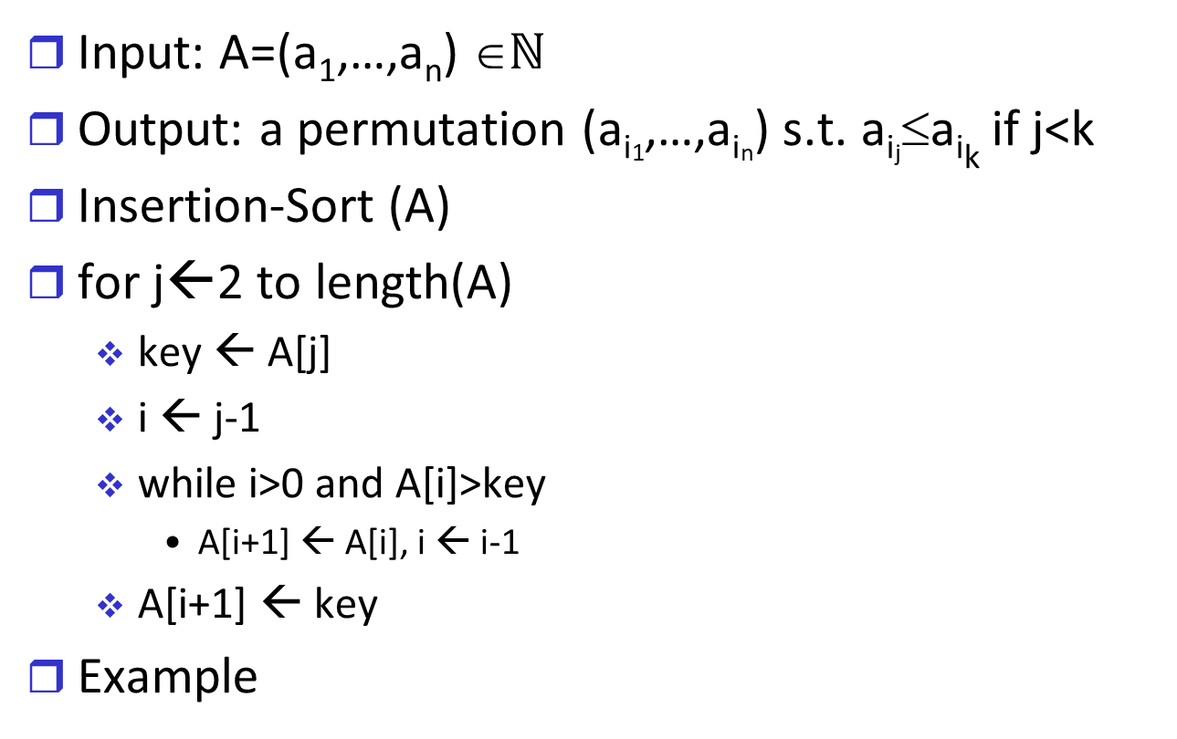
Example: Sorting
Input: A=(a₁,…,a_{n}) ∈$ℕ$
Output: a permutation (a_{i1},…,a_{in}) s.t. a_{ij}≤a_{ik} if j<k
Insertion-Sort (A)
for j←2 to length(A)
key ← A[j]
i ← j-1
while i>0 and A[i]>key
A[i+1] ← A[i], i ← i-1
A[i+1] ← key
Example

Slide 6
Correctness
Claim: At the start of the j-th execution of the outer loop A[1],…,A[j-1] are the first j-1 values of the original array sorted in order.
Corollary: after the algorithm terminates the array A is sorted

Slide 7
Complexity (Computational / Time)
Let T(x) be the running time for input x, |x|=n
Worst case
T_{worst}(n)={max T(y) | |y|=n}
Average case
Assume a probability p(x) for any input x
T_{ave}(n)=Σp(x)T(x)
Example – binary search
Worst case, average case, best case

Slide 8
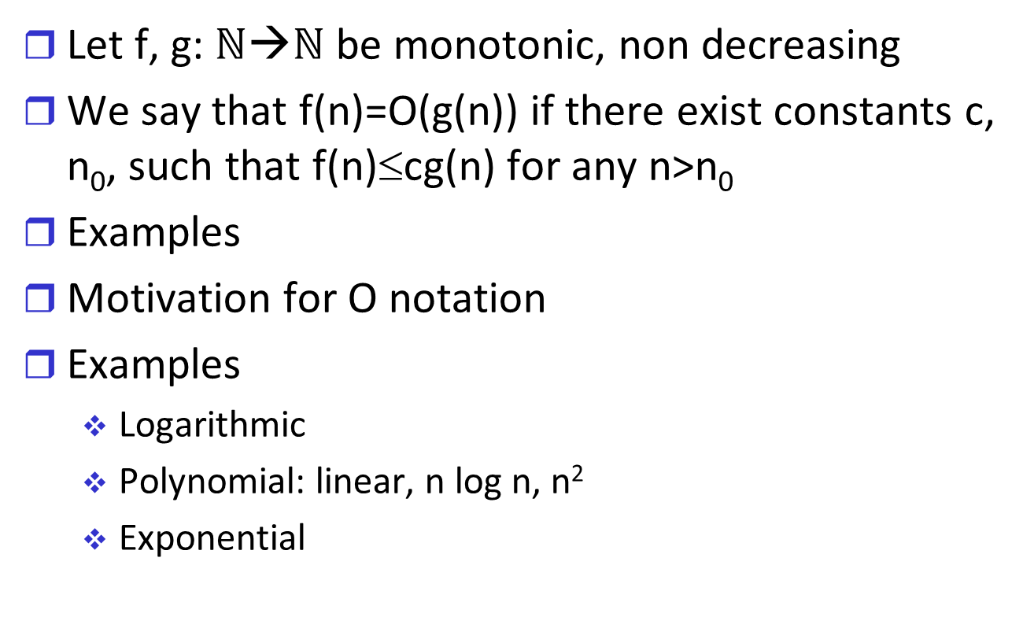
O Notation
Let f, g: $ℕ$→$ℕ$ be monotonic, non decreasing
We say that f(n)=O(g(n)) if there exist constants c, n₀, such that f(n)≤cg(n) for any n>n₀
Examples
Motivation for O notation
Examples
Logarithmic
Polynomial: linear, n log n, n²
Exponential

Slide 9
Examples I
Insert-sort
Binary search
Binary-search (A,1,n,s): find s in sorted array A
T(n) – worst case time for sorted array of n elements
T(n)=c+T(n/2)
T(n)=O(log n)

Slide 10
Examples II
s ← 0
for i ← 1 to n
for j ← 1 to n
j ← j+i
s ←s+1
Complexity
First analysis O(n²)
Finer analysis O(n log n)

Slide 11
O notation - summary
Advantages
Independence of hardware
Analysis focuses on most important terms
Disadvantages
System considerations are important
Software example
Hardware example
Asymptotic view disregards interesting parameter regimes

Slide 12
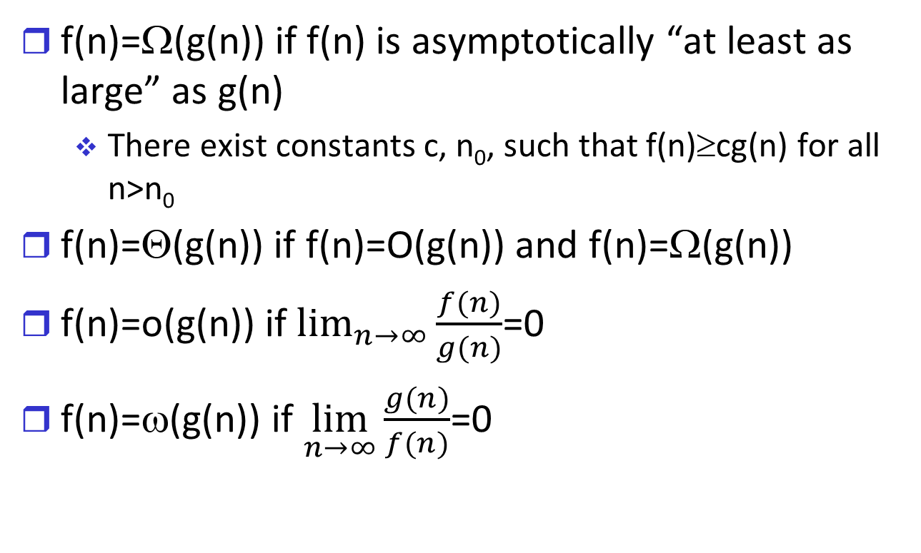
Other notation
f(n)=Ω(g(n)) if f(n) is asymptotically “at least as large” as g(n)
There exist constants c, n₀, such that f(n)≥cg(n) for all n>n₀
f(n)=Θ(g(n)) if f(n)=O(g(n)) and f(n)=Ω(g(n))
f(n)=o(g(n)) if $\lim_{n→∞}{\frac{f(n)}{g(n)}}$=0
f(n)=ω(g(n)) if $\lim_{n→∞}{\frac{g(n)}{f(n)}}$=0

